Slide 1
Elasticity

Slide 2
Elasticity
Measure of responsiveness of one variable to changes in another variable.
Four Main Types of Elasticity
Price Elasticity of Demand
Measure of responsiveness of quantity demanded to changes in price.
Income Elasticity of Demand
Measure of responsiveness of quantity demanded to changes in income.
Cross Price Elasticity of Demand
Measure of responsiveness of quantity demanded to changes in the price of related goods.
Price Elasticity of Supply
Measure of responsiveness of quantity supplied to changes in price.

Slide 3
Changes in Quantity Demanded in Response to Changes in Price
Price and Quantity Demanded are inversely related
Law of Demand
Price goes up, Quantity Demanded goes down
Price goes down, Quantity Demanded goes up
Useful to know, but provides no information on magnitude of changes

Slide 4
Why Important?
Firms: If increase price, quantity demanded will fall
How much? What will happen to total revenue?
Tax Implications: If raise tax on item, expect price will rise and quantity will fall.
What will happen to total tax revenue?

Slide 5
Price Elasticity of Demand
Price Elasticity of Demand: A measure of responsiveness of quantity demanded to changes in price.
Provides information on how much quantity demanded will change in response to a price change.
Look at percentage changes not absolute changes.
Ratio of the percentage change in quantity demanded to percentage change in price as move along the demand curve

Slide 6
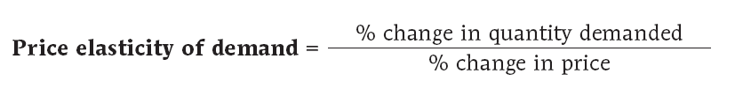
Price Elasticity of Demand

Slide 7
Calculating: Midpoint Method
The midpoint method is a technique for calculating the percent change.
Calculate changes in a variable compared with the average, or midpoint, of the starting and final values.

Slide 8
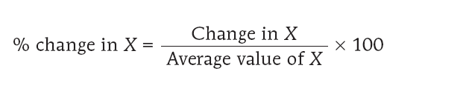
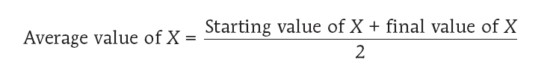
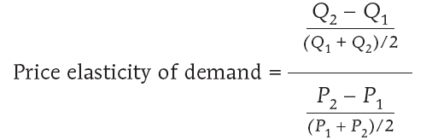
Using the Midpoint Method

Slide 9
Example
Price
When price rises to $1.10, quantity demanded falls to 900 (point B).
B
$1.10
A
0.90
Demand
0
900
1,100
Quantity

Slide 10
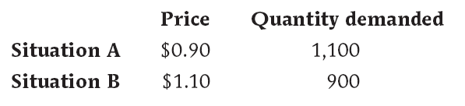

Using the Midpoint Method

Slide 11
Interpreting Price Elasticity of Demand
Must be negative (non-positive).
Why? Law of Demand
Unit-free measure (All units cancel)
Does not depend on choice of units

Slide 12
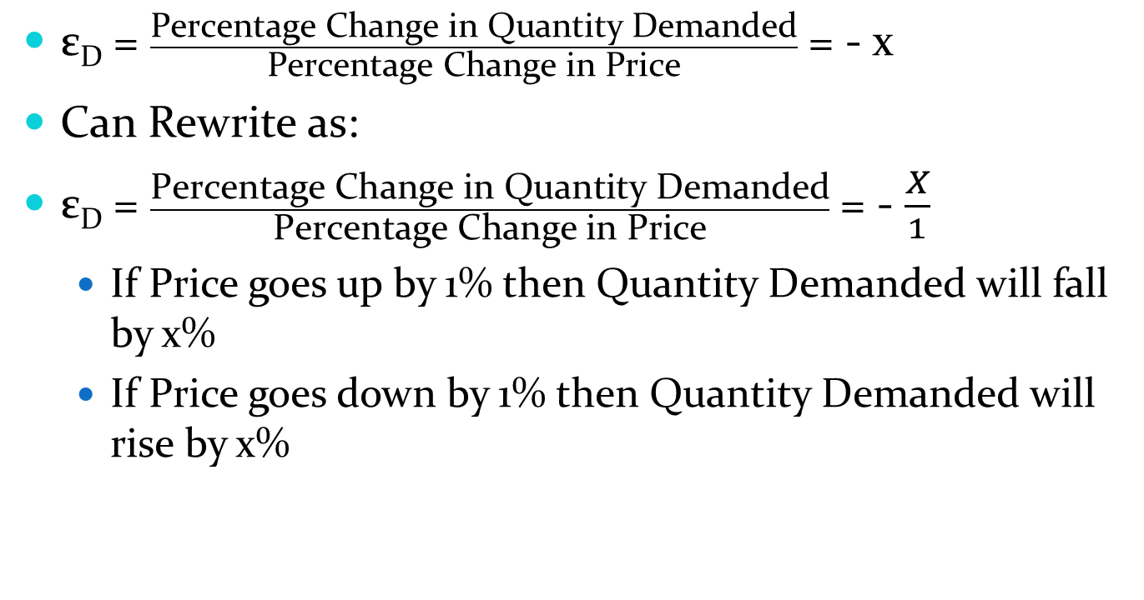
Interpreting Price Elasticity of Demand
ε_{D} = $\frac{\text{Percentage} \text{Change} \text{in} \text{Quantity} \text{Demanded}}{\text{Percentage} \text{Change} \text{in} \text{Price}}$ = - x
Can Rewrite as:
ε_{D} = $\frac{\text{Percentage} \text{Change} \text{in} \text{Quantity} \text{Demanded}}{\text{Percentage} \text{Change} \text{in} \text{Price}}$ = - $\frac{X}{1}$
If Price goes up by 1% then Quantity Demanded will fall by x%
If Price goes down by 1% then Quantity Demanded will rise by x%

Slide 13
Range of Values
Elastic Demand
-∞ ≤ ε_{D} < -1
Percentage change in Quantity greater than Percentage change in Price
Quantity demanded is “very” responsive to changes in price.
Unit Elastic Demand
ε_{D} = -1
Percentage change in Quantity is equal to Percentage change in price
Inelastic Demand
-1 < ε_{D} ≤ 0
Percentage change in Quantity less than Percentage change in Price
Quantity demanded is unresponsive to changes in price

Slide 14
Elasticity and “Steep” Demand Curves
Relatively Steep Demand Curves
Relatively “large” price changes associated with “small” quantity changes.
Quantity demanded is relatively less responsive to changes in price.
Inelastic Demand
Perfectly Vertical Demand Curves
Quantity demanded is totally unresponsive to changes in price.
Perfectly Inelastic Demand

Slide 15
Inelastic Demand
(A) Inelastic Demand: Price Elasticity of Demand = - 0.5
Price
B
A 20% increase in the price . . .
$1.10
A
0.90
Demand
0
950
1,050
Quantity
. . . generates a 10% decrease in the quantity demanded

Slide 16
Perfectly Inelastic Demand
(B)
Perfectly Inelastic Demand:
Price Elasticity of Demand = 0
Price
D
1
$1.10
A 20% increase
in price…
$0.90
… leaves the quantity demanded unchanged.
0
X
Quantity

Slide 17
Elasticity and “Flat” Demand Curves
Relatively Flat Demand Curves
Relatively “small” price changes associated with “large” quantity changes.
Quantity demanded is relatively more responsive to changes in price.
Elastic Demand
Perfectly Horizontal Demand Curves
Quantity demanded is completely responsive to changes in price.
Perfectly Elastic Demand

Slide 18
Elastic Demand
(c) Elastic Demand: Price Elasticity of Demand = -2
Price
B
A 20% increase in the price . . .
$1.10
A
0.90
Demand
0
800
1,200
Quantity
… generates a 40% decrease in the quantity demanded.

Slide 19
Perfectly Elastic Demand
(D)
Price Elasticity of Demand = - ∞
Price
At exactly $0.90, consumers will buy any quantity
At any price above $0.90, quantity demanded is zero
$0.90
D
At any price below $0.90, quantity demanded does not increase
0
Quantity

Slide 20
Determinants of Price Elasticity of Demand
Availability of Substitutes
More substitutes, more opportunity to alter behavior in response to price changes.
More substitutes = More Elastic
Time
More time that passes since price change, more opportunity to adjust behavior in response to price changes.
How Narrowly Defined
More narrowly defined, more substitutes = More Elastic
Food (Inelastic), Apples (Elastic)

Slide 21
Changes in Elasticity Along a Linear Demand Curve
Just to complicate things: Price Elasticity of Demand will change depending upon the current price and quantity.
Even along a linear demand curve (straight line demand curve with a constant slope)
Elasticity of Demand ≠ Slope of Demand Curve:

Slide 22
Unit-Elastic, Inelastic, or Elastic?
Why Does It Matter Whether Demand is Unit-Elastic, Inelastic, or Elastic?:
Because this classification predicts how changes in the price of a good will affect the total revenue earned by producers from the sale of that good.
The total revenue is defined as the total value of sales of a good or service:
Total Revenue = Price × Quantity Sold

Slide 23
Total Revenue by Area
Price
$0.90
Total revenue = price x quantity = $990
Demand
0
1,100
Quantity
Notes:
23

Slide 24
Effect of a Price Increase on Total Revenue
Price
Total Revenue at new price and quantity:
Area B + C
Total Revenue at initial price and quantity: Area A + B
$1.10
C
0.90
B
A
Demand
0
900
1,100
Quantity
Notes:
24

Slide 25
Elasticity and Total Revenue
When a seller raises the price of a good, there are two countervailing effects in action (except in the rare case of a good with perfectly elastic or perfectly inelastic demand):
A price effect: After a price increase, each unit sold sells at a higher price, which tends to raise revenue.
A quantity effect: After a price increase, fewer units are sold, which tends to lower revenue.

Slide 26
Elasticity and Total Revenue
If demand for a good is elastic (the price elasticity of demand is less than -1).
In this case, the quantity effect is stronger than the price effect.
An increase in price reduces total revenue.
If demand for a good is inelastic (the price elasticity of demand is between 0 and -1).
In this case, the price effect is stronger than the quantity effect.
An increase in price increases total revenue.

Slide 27
Elasticity and Total Revenue
If demand for a good is unit-elastic (the price elasticity of demand is exactly -1).
In this case, the quantity effect and the price effect exactly offset each other.
An increase in price does not change total revenue.

Slide 28
Other Types of Elasticity
Income Elasticity of Demand
Cross Price Elasticity of Demand
Price Elasticity of Supply

Slide 29
The Income Elasticity of Demand
The income elasticity of demand is the percent change in the quantity of a good demanded when a consumer’s income changes divided by the percent change in the consumer’s income.

Slide 30
Normal Goods and Inferior Goods
When the income elasticity of demand is positive, the good is a normal good; that is, the quantity demanded at any given price increases as income increases.
If positive and greater than 1, then considered income elastic
If positive and less than 1, then considered income inelastic.
When the income elasticity of demand is negative, the good is an inferior good; that is, the quantity demanded at any given price decreases as income increases.

Slide 31

Other Demand Elasticities: Cross-Price Elasticity
The cross-price elasticity of demand between two goods measures the effect of the change in one good’s price on the quantity demanded of the other good.
It is equal to the percent change in the quantity demanded of one good divided by the percent change in the other good’s price.
The Cross-Price Elasticity of Demand
between Goods A and B

Slide 32
Cross-Price Elasticity
Goods are substitutes when the cross-price elasticity of demand is positive.
Goods are complements when the cross-price elasticity of demand is negative.

Slide 33
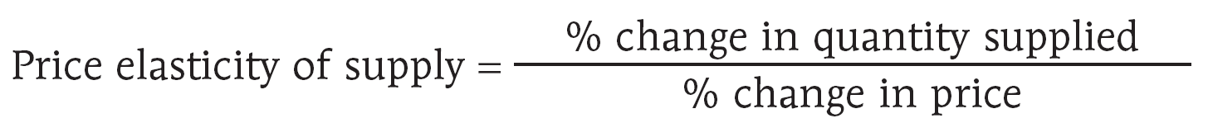
Measuring the Price Elasticity of Supply
The price elasticity of supply is a measure of the responsiveness of the quantity of a good supplied to the price of that good.
It is the ratio of the percent change in the quantity supplied to the percent change in the price as we move along the supply curve.

Slide 34
What Factors Determine the Price Elasticity of Supply?
The Availability of Inputs: The price elasticity of supply tends to be large when inputs are readily available and can be shifted into and out of production at a relatively low cost. It tends to be small when inputs are difficult to obtain.
Time: The price elasticity of supply tends to grow larger as producers have more time to respond to a price change. This means that the long-run price elasticity of supply is often higher than the short-run elasticity.

Slide 35
Two Extreme Cases of Price Elasticity of Supply
There is perfectly inelastic supply when the price elasticity of supply is zero, so that changes in the price of the good have no effect on the quantity supplied. A perfectly inelastic supply curve is a vertical line.
There is perfectly elastic supply when even a tiny increase or reduction in the price will lead to very large changes in the quantity supplied, so that the price elasticity of supply is infinite. A perfectly elastic supply curve is a horizontal line.
Notes:
35

Slide 36
Price Controls
Next Time!

